Slide 1













Detection of False Data Injection in Smart Grid
GROUP 11

Slide 2
TEAM MEMBERS
Ashwin joseph(23BCY10005)
Akshat Singh(23BCY10019)
Priyanshu Joshi(23BCY10066)
Snehasish shaw(23BCY10142)
Diyasha Singh(23BCY10154)

Slide 3
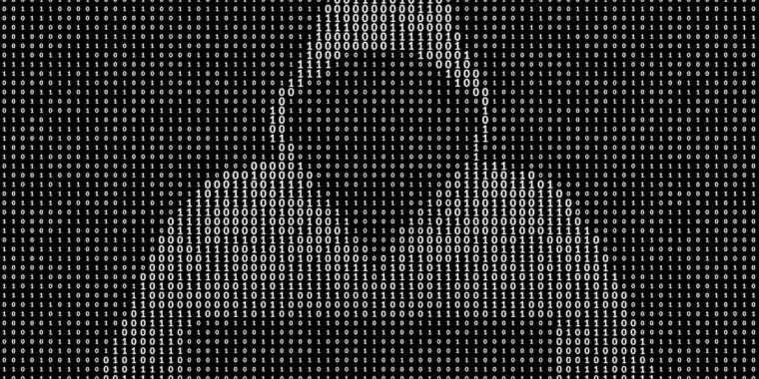
Introduction
In False Data Injection attacks, adversaries manipulate sensor readings or control signals to deceive system operators, potentially leading to blackouts, financial losses, or equipment damage. This project focuses on developing an intelligent detection system using machine learning (ML) and deep learning (DL) techniques to identify and counteract FDIAs in real time, ensuring the stability and security of smart grids.
Applications
The proposed detection system has significant implications for energy providers, enabling them to safeguard grid operations against cyber threats. Government agencies can use the research to formulate regulations for smart grid security

Slide 4

Smart Grid
A smart grid is an enhanced electricity network that uses digital communication technology to improve the efficiency, reliability, and sustainability of electricity distribution. It integrates sensors, IoT devices, real-time data analytics, and automation to manage the flow of electricity more intelligently.
Key Components
1 Smart Meters
2 Advanced Sensors and IoT Devices
3 Automated Control Systems
4 Two-Way Communication:

Slide 5
Advancements in False Data Injection (FDI) Attack Detection & Prevention
Advancement
Log Analysis: Enables early detection of anomalies through real-time monitoring and pattern recognition.
Normalization: Improves accuracy by standardizing and cleaning data from diverse sources.
Report Generation: Provides quick insights with automated summaries and visual dashboards for faster response.
Conformity Analysis: Enhances detection by comparing current data with expected behavior and policy rules.

Slide 6
Prevention
False Data Injection (FDI) attacks pose serious threats to cyber-physical systems (like smart grids), manipulating sensor data or control signals to mislead decision-making without raising traditional alarms. Recent advancements have strengthened the detection and prevention mechanisms through intelligent data handling and analysis.

Slide 7
Libraries Used and why
TensorFlow & Keras: Build and train the CNN model.
NumPy: Array operations and conformity score calculation.
Pandas: Load datasets and save reports as CSV.
Matplotlib & Seaborn: Plot accuracy, loss, ROC, and conformity distribution.
Logging: Track execution in model_logs.log.
Scikit-Learn: Preprocessing, metrics, and ROC curve.
Datetime: Add timestamps to reports.
OS: Handle file and directory operations.

Slide 8
Generating Normal Smart Grid Data
The dataset consists of 5 key electrical parameters:
Voltage (V) → Random values between 220V and 240V.
Current (A) → Random values between 5A and 15A.
Power Factor → Random values between 0.8 and 1.0.
Power (W) → Computed as Voltage × Current × Power Factor.
Frequency (Hz) → Random values between 49.5 Hz and 50.5 Hz.

Slide 9

Normalization Technique
What is StandardScaler?
StandardScaler is a feature-scaling technique in scikit-learn that standardizes data by removing the mean and scaling it to unit variance. It is commonly used in machine learning to ensure that all features have the same scale, improving model performance.
X is the original feature value,
μ\muμ is the mean of the feature,
σ\sigmaσ is the standard deviation of the feature.

Slide 10
Report Generation
Quantitative Metrics: The report (model_report.csv) provides accuracy, precision, recall, F1-score, and AUC-ROC, ensuring the model meets detection requirements.
Conformity Scores: The conformity_scores.csv file helps assess prediction confidence, identifying uncertain classifications that may need manual review.
Why It Matters:
Provides evidence of due diligence in securing the grid.
Helps meet industry and government cybersecurity standards.

Slide 11
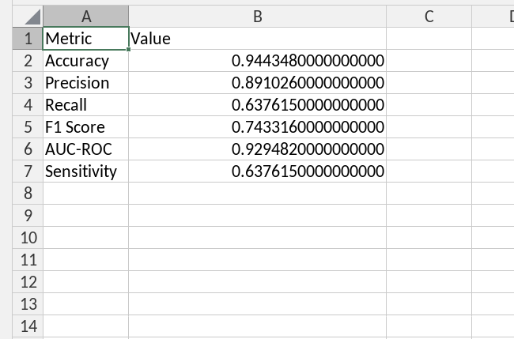
Report Generation
This is a sample report generated for a data.
Accuracy (0.944):
Measures the overall correctness of the model.
94.4% of all predictions are correct. High accuracy, but can be misleading if classes are imbalanced.
Precision (0.891):
Indicates how many predicted positive cases are actually positive.
89.1% of positive predictions are correct. High precision means fewer false positives.
Recall (Sensitivity) (0.638):
Measures how many actual positive cases are correctly predicted.
63.8% of true positives are identified. Lower recall suggests the model misses some positives (false negatives).

Slide 12
Report Generation
F1 Score (0.743):
Harmonic mean of precision and recall. Balances both metrics.
0.743 indicates a moderate balance (closer to 1 is better).
AUC-ROC (0.929):
Evaluates the model’s ability to distinguish between classes.
0.929 (close to 1) shows excellent classification performance.
Sensitivity (0.638):
Same as recall. Confirms 63.8% of actual positives are captured.

Slide 13
Conformity Scores
The train_and_evaluate() function:
Splits data into train (80%) and test (20%) sets using train_test_split().
Computes conformity scores only for the test set:
Importance
Provides an unbiased estimate of model confidence on new, unseen samples.
The current implementation correctly focuses on test-set conformity scores for reliable evaluation

Slide 14
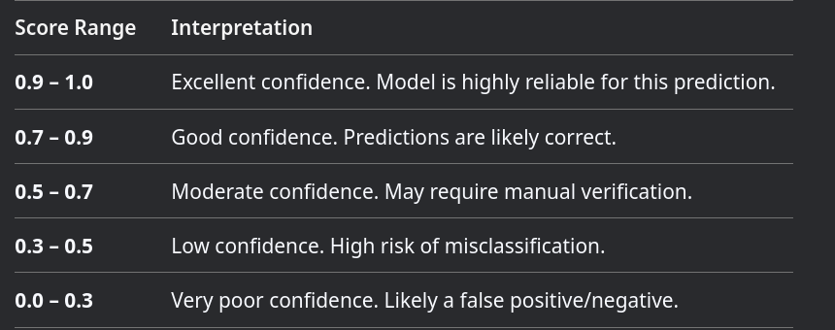
Conformity Score Interpretation
Formula:
Conformity Score = 1 - |Predicted Probability - True Label|
Good Scores: Close to 1.0 (model is confident and correct).
Bad Scores: Close to 0.0 (model is wrong or uncertain).

Slide 15
How does this neural network work? (1)
Architecture: Sequential model with 4 dense layers (128, 64, 32, 1 neurons)
Initialization: Uses He normal initialization for weight matrices
Activation:
- First layer: Swish activation
- Hidden layers: LeakyReLU (α=0.01) with Batch Normalization
- Output: Sigmoid (for binary classification)
Regularization:
- Dropout (20%) after first two hidden layers
- Batch Normalization between layers

Slide 16
How does this neural network work? (2)
Optimization: Adam optimizer with learning rate 0.0005
Loss Function: Binary cross-entropy (standard for binary classification)
Metrics Tracked: Accuracy and AUC during training
Input Processing: Features are standardized using StandardScaler
Training: 150 epochs with batch size 50, 20% validation split
Output Interpretation:
- >0.5 = "False Data"
- ≤0.5 = "

Slide 17
Timeline
We are using conformal neural network for this project
03 Reporting,
conformity analysis and plotting graphs
04 Log analysis reanalysing the data
01
Analysis and Requirements
02 Dataset generation and normalization
Done
Done
Done
Done

Slide 18

Conclusion
The increasing reliance on smart grids brings both efficiency and vulnerability. This study demonstrates how False Data Injection (FDI) attacks can manipulate power system data, leading to potential instability and financial losses. By simulating FDI attacks on key electrical parameters like voltage, power, and frequency, we highlight the importance of robust intrusion detection systems (IDS) and machine learning-based anomaly detection.
To ensure the security and resilience of smart grids, it is essential to:
Implement real-time monitoring with AI-driven anomaly detection.
Enhance cybersecurity protocols to prevent unauthorized data manipulation.
Continuously analyze and update grid security measures against evolving threats.

Slide 19
Future Scope
As cyber threats evolve, future research can explore:
🔸 Deep Learning Models for better attack detection.
🔸 Blockchain-based security for tamper-proof data integrity.
🔸 Advanced cryptographic methods to prevent unauthorized access.
By adopting proactive security strategies, we can fortify smart grids against cyberattacks and ensure a stable, reliable, and secure power infrastructure.

Slide 20
Thank You!

